Slide 1
COSC 419 Topics in Computer Science Artificial intelligence
Mohamad Khajezade
Okanagan College
mkhajezade@okanagan.bc.ca

Slide 2
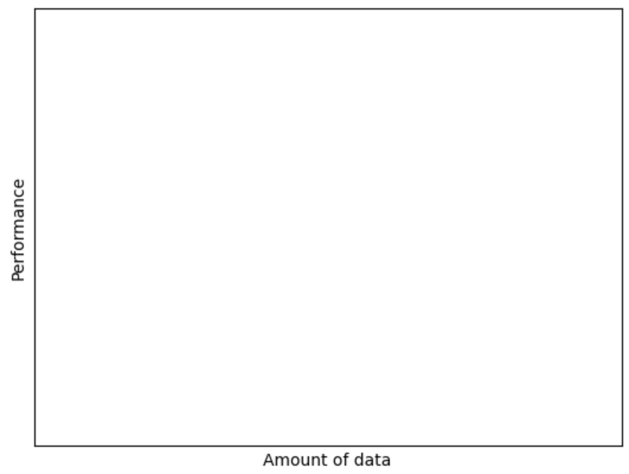





Why Deep Learning Now?
Performance of traditional models stops improving after a certain point, no matter how much data is used to train them.
Digitalization provided us with a huge amount of data
Deep neural networks can perform significantly better than traditional models when trained on more data
Transformers
Large NN
Medium NN
Small NN
Traditional
Notes:
Similar to adding flavor and egg. We mix different features. Using this architecture, the price (output) is describe based on the combination of these features.

Slide 3
Scaling Law
Performance of a transformer model can be estimated accurately by two factors:
Number of parameters that the model has. These parameters include the embedding space and the number of tokens that are generated by the tokenizer as well as the number of layers in the model
The quality of the data used to train the model is crucial. Data collected from the internet is often not clean. The better the quality of the data, the better the model’s performance
Transformers
Large NN
Medium NN
Small NN
Traditional
Notes:
Similar to adding flavor and egg. We mix different features. Using this architecture, the price (output) is describe based on the combination of these features.

Slide 4
General Tasks In Machine learning (In General)
Classification
Description: Assigning input data to one of several predefined categories or labels.
Examples: Email spam detection, image classification (e.g., cat vs. dog), sentiment analysis (positive/negative).
Regression
Description: Predicting a continuous value based on input data.
Examples: Forecasting stock prices, and estimating temperatures.
Clustering
Description: Grouping similar data points together without predefined labels.
Examples: Customer segmentation, document clustering, and image segmentation.
Generation
Description: Creating new data that is similar to the training data.
Examples: Text generation (e.g., GPT models), image generation (e.g., GANs), and music generation.
Transformers
Large NN
Medium NN
Small NN
Traditional
Notes:
Similar to adding flavor and egg. We mix different features. Using this architecture, the price (output) is describe based on the combination of these features.

Slide 5
General Tasks In Machine learning (In General)
Ranking
Description: Ordering data points according to some criteria, often used in recommendation systems or search engines.
Examples: Search result ranking, recommendation systems (e.g., ranking products or movies), and web page ranking.
Reinforcement learning
Description: Learning optimal actions or strategies by interacting with an environment and receiving feedback (rewards or penalties).
Examples: Game playing (e.g., AlphaGo), robotic control, and self-driving cars.
Transformers
Large NN
Medium NN
Traditional
Notes:
Similar to adding flavor and egg. We mix different features. Using this architecture, the price (output) is describe based on the combination of these features.

Slide 6
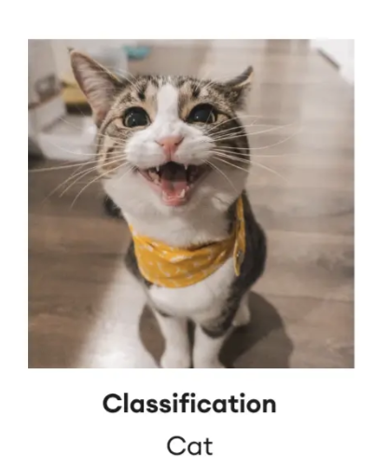
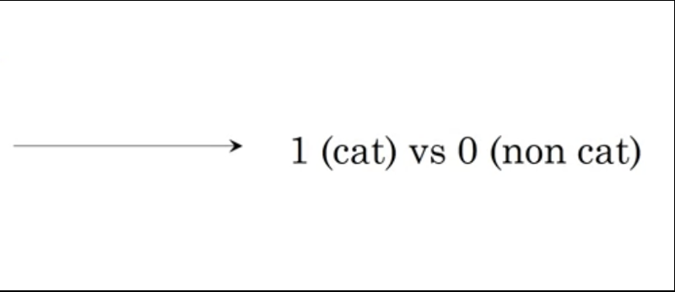
Logistic Regression
Logistic regression is an algorithm used for binary classification
In binary classification, we intend to used eighter 1, or 0 as the output
Binary classification is a common problem (task) in various fields. Examples: Code Clone Detection, Image Classification, Spam Detection.
Transformers
Large NN
Traditional
Notes:
Similar to adding flavor and egg. We mix different features. Using this architecture, the price (output) is describe based on the combination of these features.

Slide 7
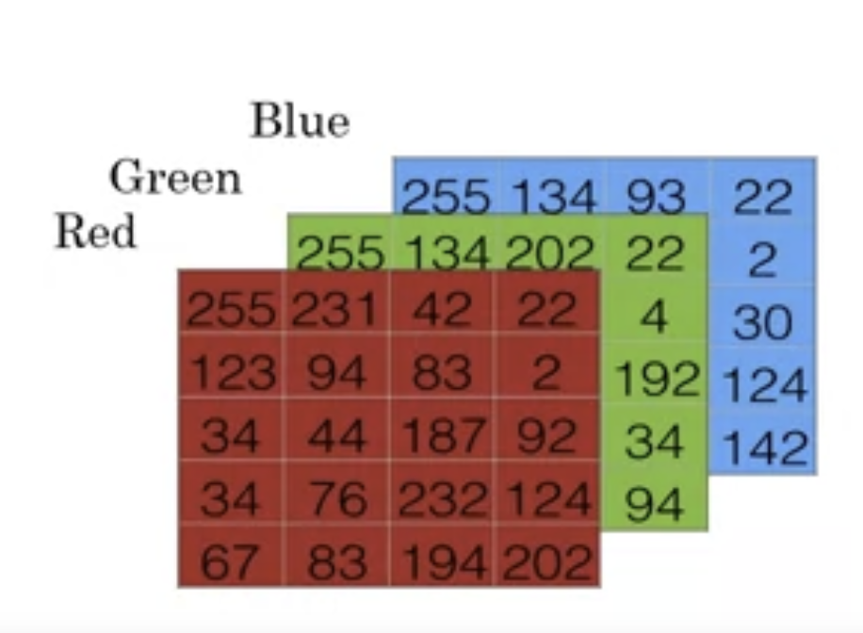
Logistic Regression
Logistic regression is an algorithm used for binary classification
In binary classification, we intend to used eighter 1, or 0 as the output
Binary classification is a common problem (task) in various fields. Examples: Code Clone Detection, Image Classification, Spam Detection.
Transformers
Large NN
255
231
..
..
..
194
203
..
..
Traditional
Notes:
Similar to adding flavor and egg. We mix different features. Using this architecture, the price (output) is describe based on the combination of these features.

Slide 8



Logistic Regression
Logistic regression is an algorithm used for binary classification
In binary classification, we intend to used eighter 1, or 0 as the output
Binary classification is a common problem (task) in various fields. Examples: Code Clone Detection, Image Classification, Spam Detection.
$$64 ×64$$
Transformers
Large NN
255
231
..
..
..
194
203
..
..
$$Size$$
$$64 ×64 ×3$$
Traditional
Notes:
Similar to adding flavor and egg. We mix different features. Using this architecture, the price (output) is describe based on the combination of these features.

Slide 9

Logistic Regression
Logistic regression is an algorithm used for binary classification
In binary classification, we intend to used eighter 1, or 0 as the output
Binary classification is a common problem (task) in various fields. Examples: Code Clone Detection, Image Classification, Spam Detection.
$$64 ×64$$
Transformers
Large NN
255
231
..
..
..
194
203
..
..
$$Size=n_{x}$$
X
$$64 ×64 ×3$$
Traditional
Y = X
Notes:
Similar to adding flavor and egg. We mix different features. Using this architecture, the price (output) is describe based on the combination of these features.

Slide 10

Logistic Regression
Logistic regression is an algorithm used for binary classification
In binary classification, we intend to used eighter 1, or 0 as the output
Binary classification is a common problem (task) in various fields. Examples: Code Clone Detection, Image Classification, Spam Detection.
$$64 ×64$$
Transformers
Large NN
X
Y $∈\left\{0, 1\right\}$
Traditional
Notes:
Similar to adding flavor and egg. We mix different features. Using this architecture, the price (output) is describe based on the combination of these features.

Slide 11
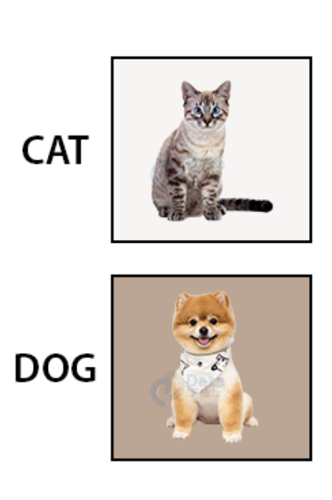



Examples and Notations
$$(x, y)$$
Transformers
Label (Cat or Non Cat)
Y $∈\{0, 1\}$
Large NN
Examples (Images)
x$∈ℝ^{n_{x}}$
Traditional
Notes:
Similar to adding flavor and egg. We mix different features. Using this architecture, the price (output) is describe based on the combination of these features.

Slide 12


Examples and Notations
M training examples: {($x^{(1)}, y^{1}$),($x^{(2)}, y^{2}$),…,($x^{(m)}, y^{m})\}$
Transformers
M training examples: {(${image}^{(1)}, {label}^{1}$),(${image}^{(2)}, {label}^{2}$),…,(${image}^{(m)}, {label}^{m})\}$
Large NN
N test examples: Similar to training. However we don’t used them to train the model, but to evaluate the performance
Traditional
Notes:
Draw the chart and show them what is the difference between train and test

Slide 13







Examples and Notations
..
..
..
$$X_{(1)}$$
..
..
..
..
..
$$X_{(2)}$$
..
..
….
..
..
..
$$X_{(m)}$$
..
..
Transformers
X=
$$n_{x}$$
Large NN
m
$y_{(1)}$,
$y_{(2)}$,
….
$$y_{(m)}$$
Traditional
Y=
Notes:
Draw the chart and show them what is the difference between train and test

Slide 14
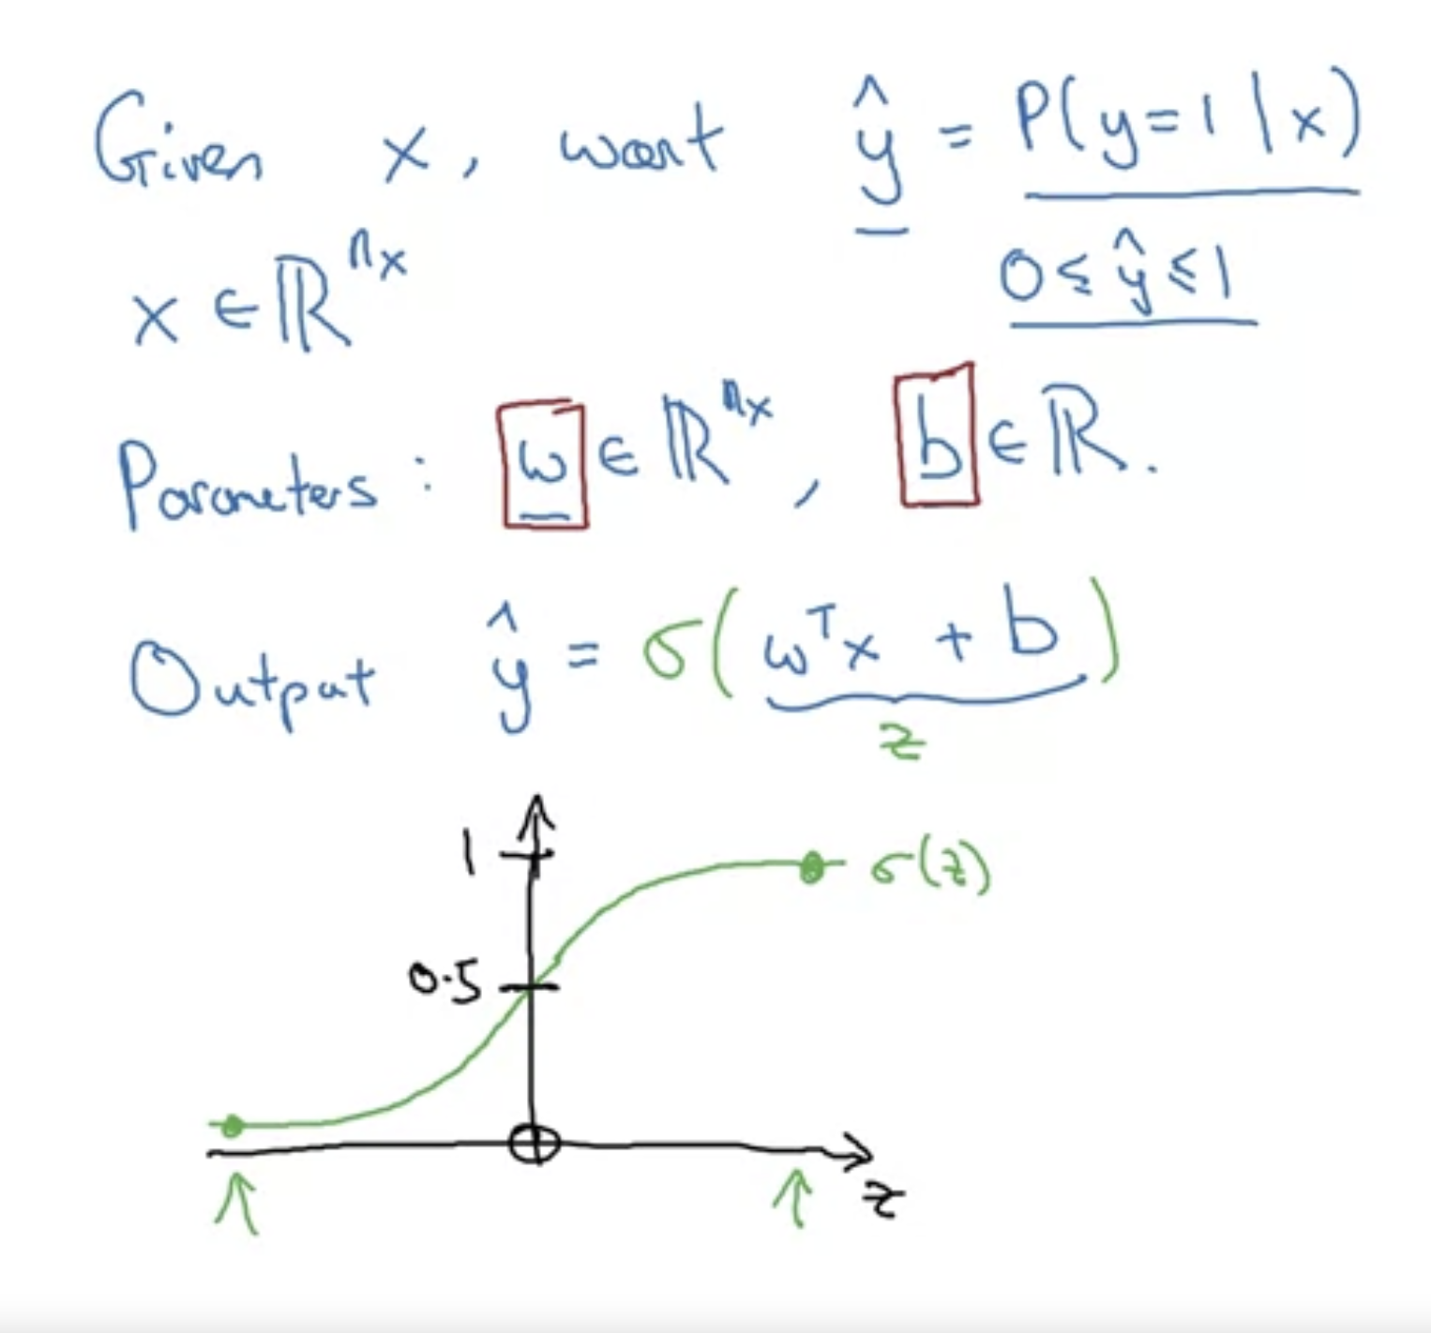
Logistic Regression Notation
Transformers
Large NN
Traditional

